Slide 1
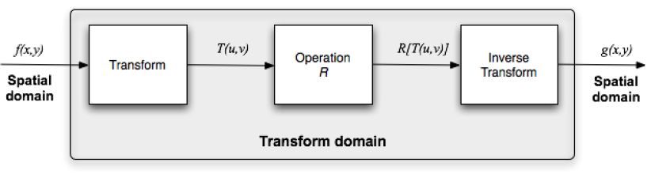
Overview of image processing operations
Spatial domain
Transform domain (Frequency Domain)
COMSATS Institute of Information Technology, Lahore Digital Image Processing CSC331

Slide 2
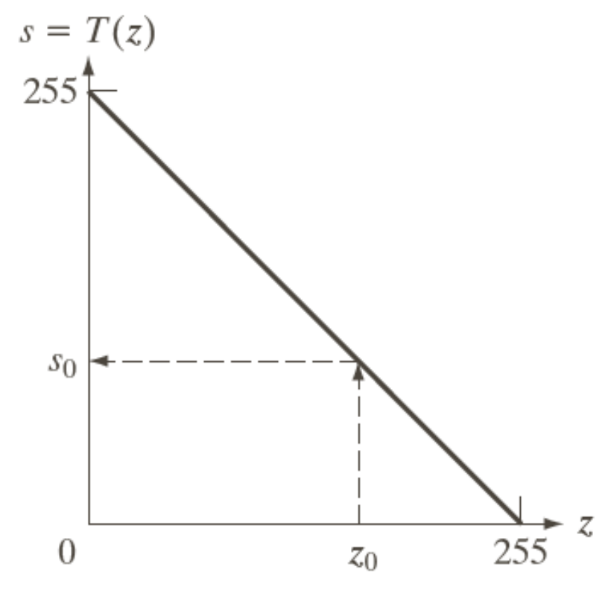
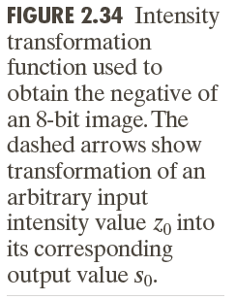
Spatial Operations
Single Pixel Operations (Point Operations), s = T(z)
Neighborhood Operations
Geometric Spatial Transformations and Image Registration
COMSATS Institute of Information Technology, Lahore Digital Image Processing CSC331

Slide 3
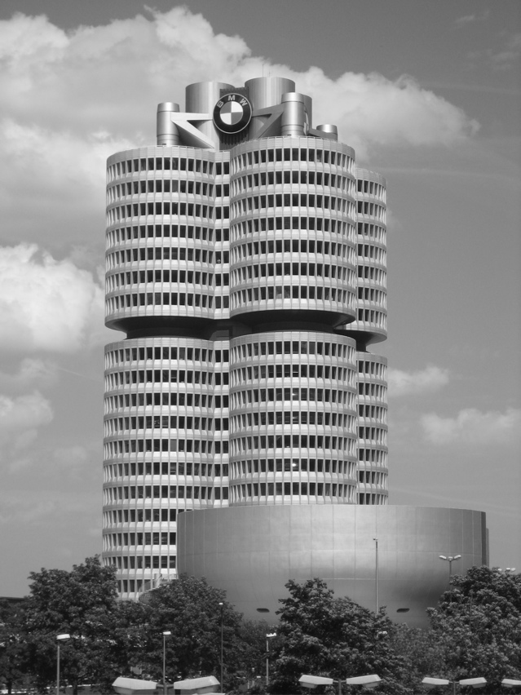
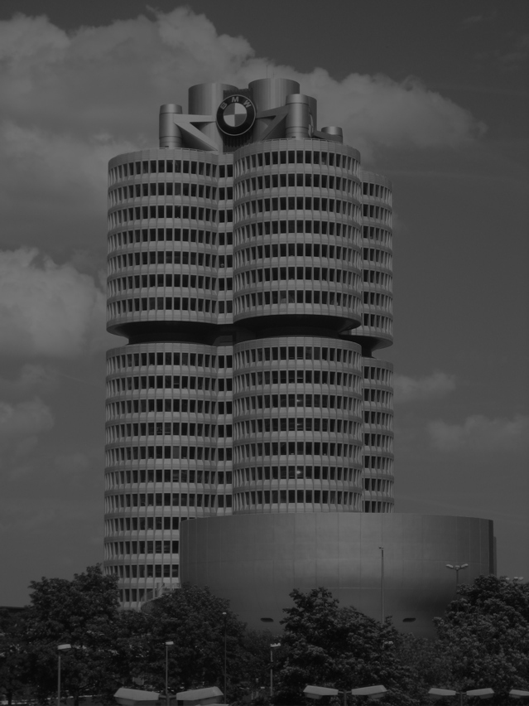
Point Operations
Example:
s = r/2
COMSATS Institute of Information Technology, Lahore Digital Image Processing CSC331

Slide 4
Spatial Operations - Neighborhood Operations
Neighborhood-oriented operations consist of determining the resulting pixel value at coordinates (x,y) as a function of its original value and the value of (some of) its neighbors, using a convolution operation.
The convolution of a source image with a small 2D array (mask or kernel) produces a destination image.
The convolution mask determines which neighbors are used as well as the relative weight of their original values.
COMSATS Institute of Information Technology, Lahore Digital Image Processing CSC331

Slide 5
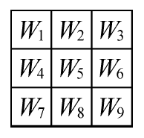
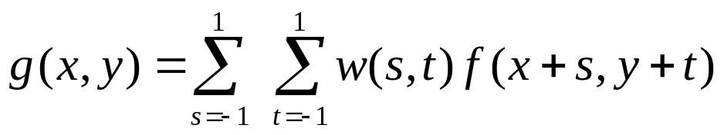
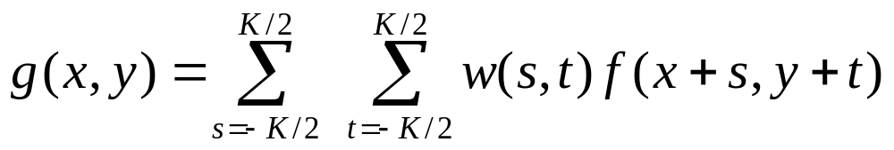
Spatial Operations - Neighborhood Operations
Masks are normally 3×3.
Each mask coefficient can be interpreted as a weight.
COMSATS Institute of Information Technology, Lahore Digital Image Processing CSC331

Slide 6
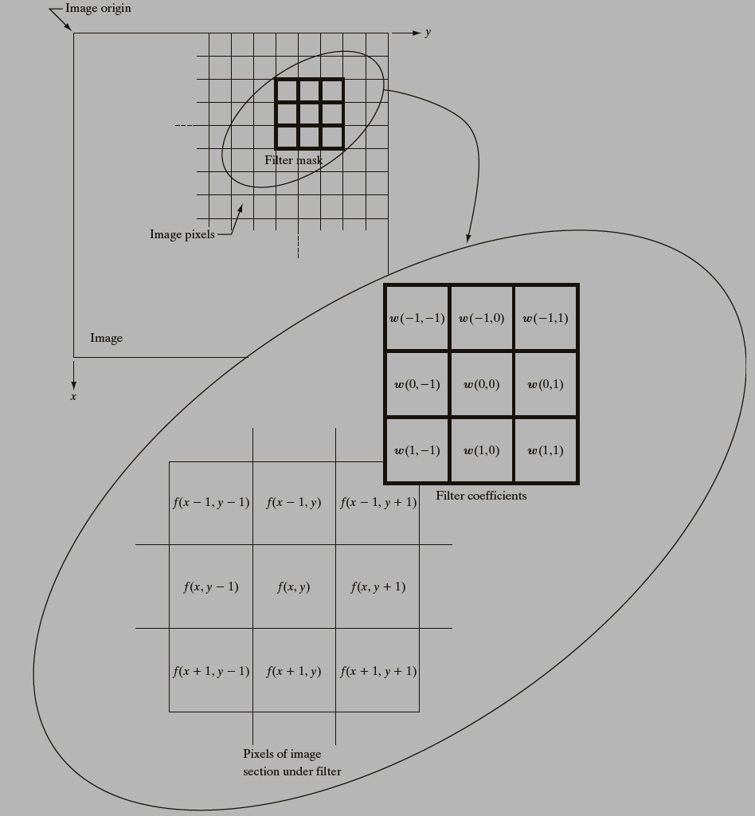
Spatial Operations - Neighborhood Operations
COMSATS Institute of Information Technology, Lahore Digital Image Processing CSC331

Slide 7
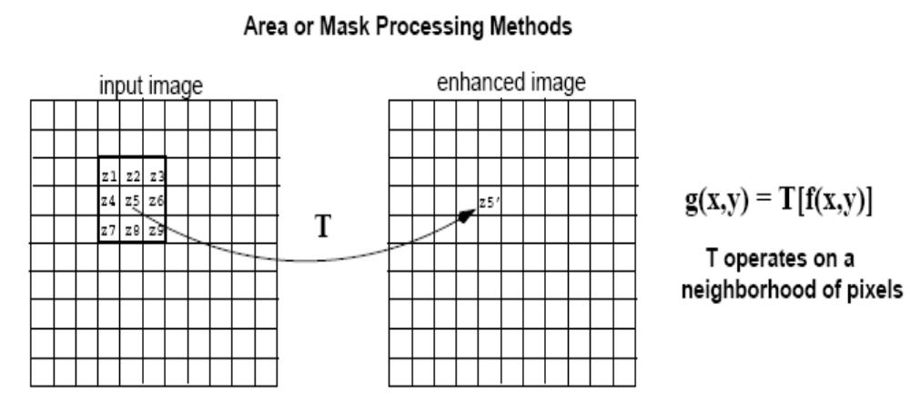
Spatial Operations - Neighborhood Operations
A filtered image is generated as the center of the mask moves to every pixel in the input image.
output image
COMSATS Institute of Information Technology, Lahore Digital Image Processing CSC331

Slide 8
Spatial Operations - Neighborhood Operations
Problems ?
Assignment (Applying a mask)
COMSATS Institute of Information Technology, Lahore Digital Image Processing CSC331

Slide 9
Spatial Operations - Neighborhood Operations
Arithmetic/Logic Operations:
-Addition : p + q
–Subtraction: p –q
–Multiplication: p*q
–Division: p/q
–AND: p AND q
–OR : p OR q
–Complement: NOT(q)
COMSATS Institute of Information Technology, Lahore Digital Image Processing CSC331

Slide 10
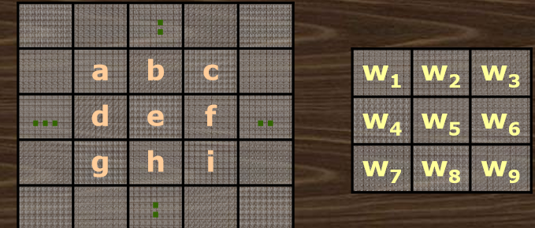
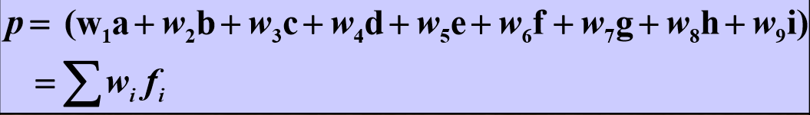
Spatial Operations - Neighborhood Operations
Neighborhood based arithmetic/Logic:
Value assigned to a pixel at position ‘e’ is a function of its neighbors and a set of window functions.
COMSATS Institute of Information Technology, Lahore Digital Image Processing CSC331

Slide 11
Spatial Operations - Neighborhood Operations
Arithmetic/Logic Operations •
Tasks done using neighborhood processing:
–Smoothing / averaging
–Noise removal / filtering
–Edge detection
–Contrast enhancement
COMSATS Institute of Information Technology, Lahore Digital Image Processing CSC331

Slide 12
Spatial Filtering (Neighborhood Processing)
Linear Spatial Filtering
0 -1 0
-1 4 -1
0 -1 0
2 3 5 7 2
3 4 7 5 2
5 6 5 3 1
2 6 2 2 1
7 3 3 2 0

Slide 13
Spatial Filtering (Neighborhood Processing)
Linear Spatial Filtering
0 -1 0
-1 4 -1
0 -1 0
2 3 5 7 2
3 4 7 5 2
5 6 5 3 1
2 6 2 2 1
7 3 3 2 0

Slide 14
Spatial Filtering (Neighborhood Processing)
Linear Spatial Filtering
0 -1 0
-1 4 -1
0 -1 0
2 3 5 7 2
3 4 7 5 2
5 6 5 3 1
2 6 2 2 1
7 3 3 2 0
2

Slide 15
Spatial Filtering (Neighborhood Processing)
Linear Spatial Filtering
0 -1 0
-1 4 -1
0 -1 0
2 3 5 7 2
3 4 7 5 2
5 6 5 3 1
2 6 2 2 1
7 3 3 2 0
2
1

Slide 16
Spatial Filtering (Neighborhood Processing)
Linear Spatial Filtering
0 -1 0
-1 4 -1
0 -1 0
2 3 5 7 2
3 4 7 5 2
5 6 5 3 1
2 6 2 2 1
7 3 3 2 0
2 1
3

Slide 17
Spatial Filtering (Neighborhood Processing)
Linear Spatial Filtering
0 -1 0
-1 4 -1
0 -1 0
2 3 5 7 2
3 4 7 5 2
5 6 5 3 1
2 6 2 2 1
7 3 3 2 0
2 1 3
16

Slide 18
Spatial Filtering (Neighborhood Processing)
Linear Spatial Filtering
0 -1 0
-1 4 -1
0 -1 0
2 3 5 7 2
3 4 7 5 2
5 6 5 3 1
2 6 2 2 1
7 3 3 2 0
2 1 3 16
-1

Slide 19
Spatial Filtering (Neighborhood Processing)
Linear Spatial Filtering
0 -1 0
-1 4 -1
0 -1 0
2 3 5 7 2
3 4 7 5 2
5 6 5 3 1
2 6 2 2 1
7 3 3 2 0
2 1 3 16 -1
1

Slide 20
Spatial Filtering (Neighborhood Processing)
Linear Spatial Filtering
0 -1 0
-1 4 -1
0 -1 0
2 3 5 7 2
3 4 7 5 2
5 6 5 3 1
2 6 2 2 1
7 3 3 2 0
2 1 3 16 -1
1
-3

Slide 21
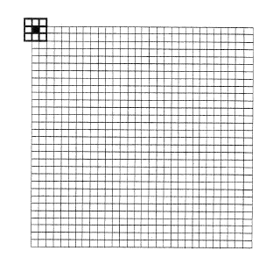
Spatial Operations - Neighborhood Operations
Solutions ?
pad with zeroes
0 0 0 ……………………….0
0 0 0 ……………………….0
COMSATS Institute of Information Technology, Lahore Digital Image Processing CSC331

Slide 22
Spatial Operations - Neighborhood Operations
Issues
–Choice of wi‘s(N2values)
–Choice of N, window size
–Computation at boundaries
•Do not compute at boundaries
•Pad with zeros and extend image boundary
•Pad assuming periodicity of image
COMSATS Institute of Information Technology, Lahore Digital Image Processing CSC331

Slide 23

COMSATS Institute of Information Technology, Lahore Digital Image Processing CSC331

